Slide 1
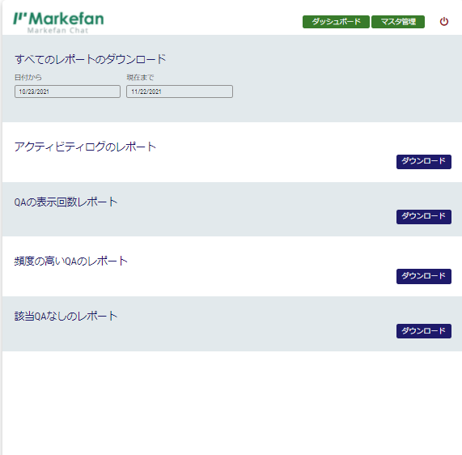
②
③
④
⑤
⑥
⑦
⑧

